Slide 1
FA2022 Week 05
OSINT I
Thomas Quig, Julius White, Danny Poje

Slide 2
Announcements
Fall CTF went great
Approx. 300 Attendees!
Social Event this weekend (Saturday)
Vote on what it will be by Friday @ 7PM
Back to 1404???
We don't know when… earliest Oct 7.

Slide 3
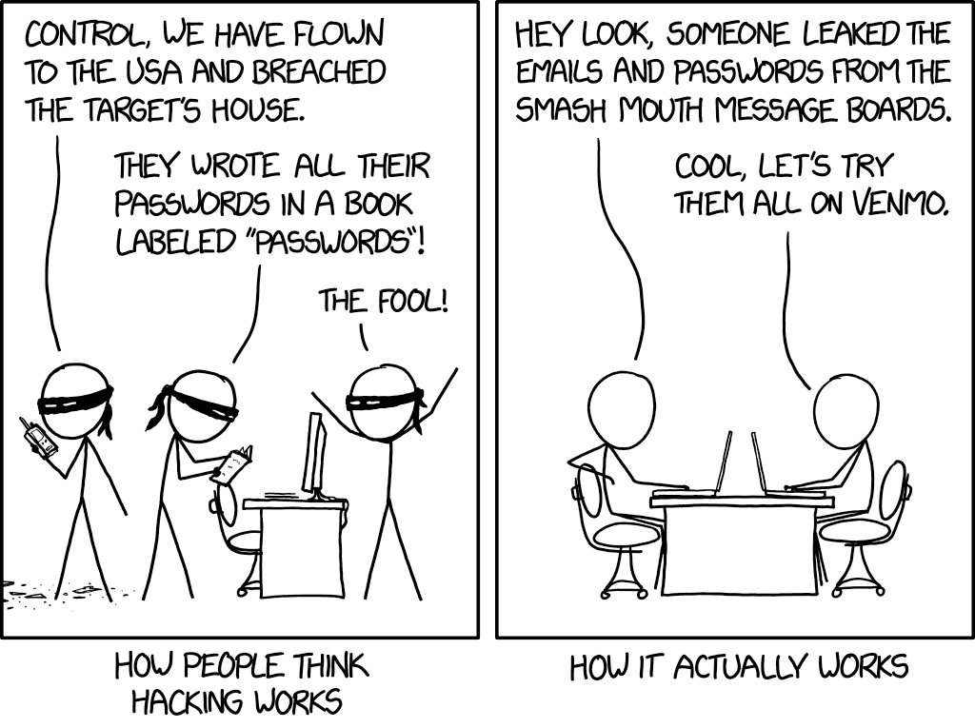
ctf.sigpwny.com
sigpwny{praise_tobac}

Slide 4
OSINT
Open Source INTelligence

Slide 5
What is OSINT
Open Source
The stuff you are gathering is accessible to the general public
If it is not immediately accessible, it will be
Intelligence
Information that can be used / is valuable for some operation.
Big range of value
Birthdays and usernames >> post content etc.
Pseudonyms
Recon, Cyberreconnisance, HUMINT etc.
Generally considered "easy" in security (not true)

Slide 6
A Warning (OSINT Ethics)
OSINT, especially HUMINT (Human Intelligence) is functionally stalking.
DON'T BE A CREEP
Make sure you have permission before OSINTing someone/thing
You could find something you don’t like / aren't supposed to

Slide 7
Explicit OSINT Code of Ethics
1. You will not INTERACT with any user without first confirming with absolute certainty that they are a part of the challenge. In the case of these challenges, there is no need to create any content
2. You will not perform any port scans on backend services or attempt to do any investigation by logging in to any of the aforementioned accounts. This is not web hacking
3. You will not perform invasive investigative OSINT on other people without their explicit consent. This includes friends, family, coworkers, and strangers.
While exceptions exist to this code, those exceptions don't apply here!

Slide 8

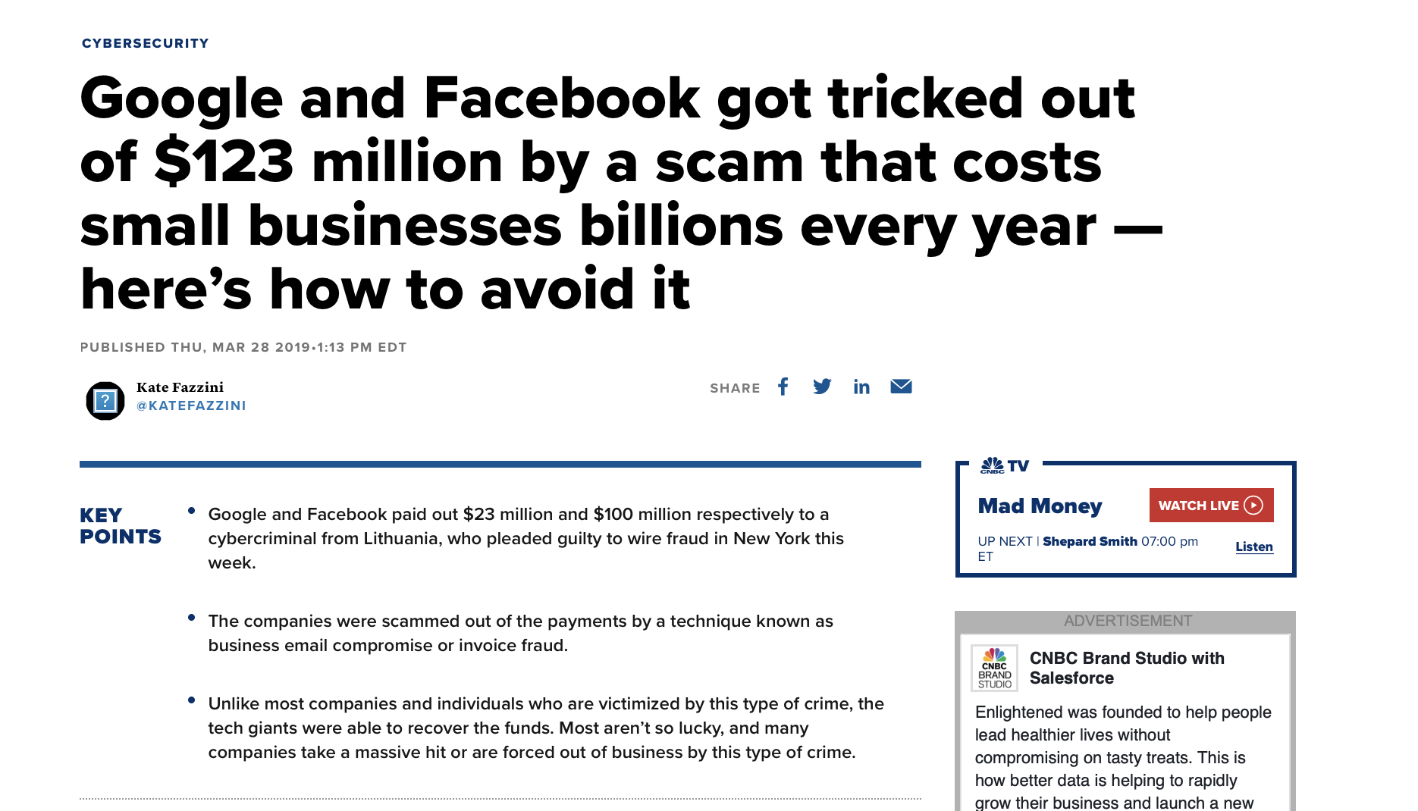
Why is this important?

Slide 9
Types of Intelligence
Systems Intelligence
Network Intelligence
Organizational Intelligence
Human Intelligence ← Primary focus of today's talk

Slide 10
Systems Intelligence
What is it made of?

Slide 11
Systems Intelligence - Summary
Get information about a system you are attacking.
Trick the system into giving you that information voluntarily
Methods
Port scanning
Information probes
IRL Intelligence

Slide 12
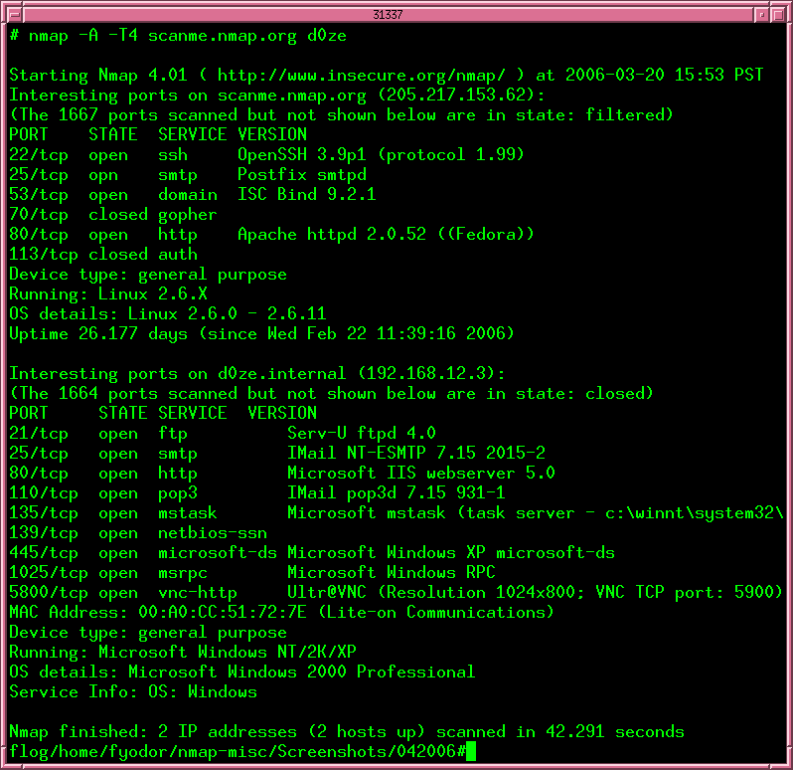
Sys Intel - Port Scanning
Identify what services are being offered by a system
This is OSINT only because the information is public to the internet
When you do this on a local network, it becomes “network enumeration”
What ports matter from a system
Depends on where you are attacking
A lot of ports are reserved for dated and deprecated services (port 376)

Slide 13
Port Scanning - Common Ports
Port | Service | Port | Service | Port | Service | Port | Service
20-21 | FTP (File Transfer) | 137-139 | NetBIOS (Sessions) | 530 | RPC (Remote Procedure Calls) | 3479 | PlayStation Network
22 | SSH (Secure Shell) | 156 | SQL (Databases) | 666 | Doom ONLINE | 4070 | Amazon Echo Dot → Spotify
23 | Telnet (Text comms) | 194 | IRC (Chatting) | 666 | Aircrack-ng C2 Server | 4444 | Metasploit listener
25 | SMTP (Mail Transfer) | 311 | macOS Server (Admin) | 740-754 | Kerberos related stuff | 5000 | AirPlay (Among Others)
53 | DNS (Domains) | 389 | LDAP (Windows) (Active Directory Access) | 1776 | EMIS (1st Responders) | 5900 | VNC (Virtual Network Computing)
67-68 | Bootstrap / DHCP | 443 | HTTPS (Websites) | 3074 | Xbox for Windows | 5985 | Powershell (Remote Management)
80 | HTTP (Websites) | 444 | AD (Windows) (Active Directory) | 3306 | MySQL (Databases) | 8080 | Alternate HTTP (Also 8000 / 8008)
88 | Kerberos (Authentication) | 445 | SMB (Windows) | 3389 | RDP (Microsoft Remote) | 25565 | Minecraft Server
https://en.wikipedia.org/wiki/List_of_TCP_and_UDP_port_numbers

Slide 14
Port Scanning - Methods
nmap
best port scanning tool
will have tutorial in networking meeting
Alternatives = masscan
shodan
Google but for networked devices (REALLY COOL)
Aquatone
Look for valid browser-readable content, display on aggregate webpage.
Try making your own aquatone in python with just links!

Slide 15
Port Scanning - Implications
Adversarial
Ports being open can often provide information about a system.
If 80, 443, and 8080 are open it probably has a website.
But if 53, 445, 3389, etc… it is likely a Domain Controller (DC)
Ethical / Legal
Port scanning can harm system availability
Starts to enter a legally / ethically grey area
DO NOT PORTSCAN THE GODDAMN US GOVERNMENT

Slide 16
Sys Intel - Information Probes
Gather System information by requesting that information.
CrackMapExec (Great tool) will display version of OS interacted with upon probe completion.
Shodan can also do this stuff sometimes
This is usually case-by-case, I will update this slide if my knowledge changes

Slide 17
Sys Intel - Info Probe Methods
nmap can help w this, find what services are offered then probe them for more information.
nmap scripts exist too for “banner grabbing”
It really depends on what services the system is offering

Slide 18
Sys Intel - IRL Intelligence
Walk up to a device, look at the make/model.
Useful if you have supervised physical access / photos.
If you have physical access to something, chances are you are beyond needing to do OSINT (just plug in a ducky)

Slide 19
Network Intelligence
Where is it and who is it talking to?

Slide 20
Network Intelligence - Summary
Like system intelligence, but focused more on communications.
Given a network of systems, who talks to who and why.
What is the dataflow to, from, and within a network
A lot of what you do here is going to be on Windows, so this section will be more geared towards that.

Slide 21
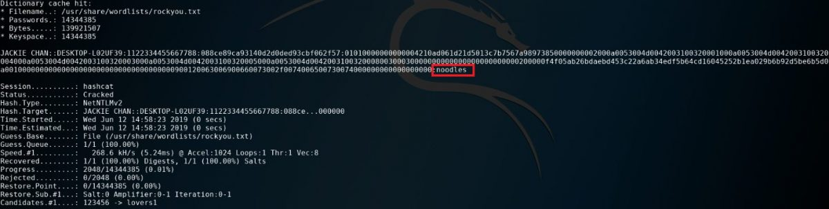
Network Intelligence - Methods
Depending on context, ASK
Social Engineering → find reason to know, ask
Internal Pentesting (yourself/org) → ask IT person who knows.
Shodan also usually great for this
Find hub devices and set up monitoring / spoofing on them
Responder is a spoofing tool, but you can also use it to get a list of devices

Slide 22
Network Intelligence Methods 2
Enumeration
NSLookup is your friend on Windows stuff
Given a username, what information does it tell you about other usernames.
Take one name for a device, guess others
Ldap Abuse
Ldap is a great protocol when used properly.
Abuse the hell out of it, dump everything (probably need credentials)
More on this in the pentesting meeting (probably next semester)

Slide 23
Organizational Intel
What are they doing!?!?

Slide 24
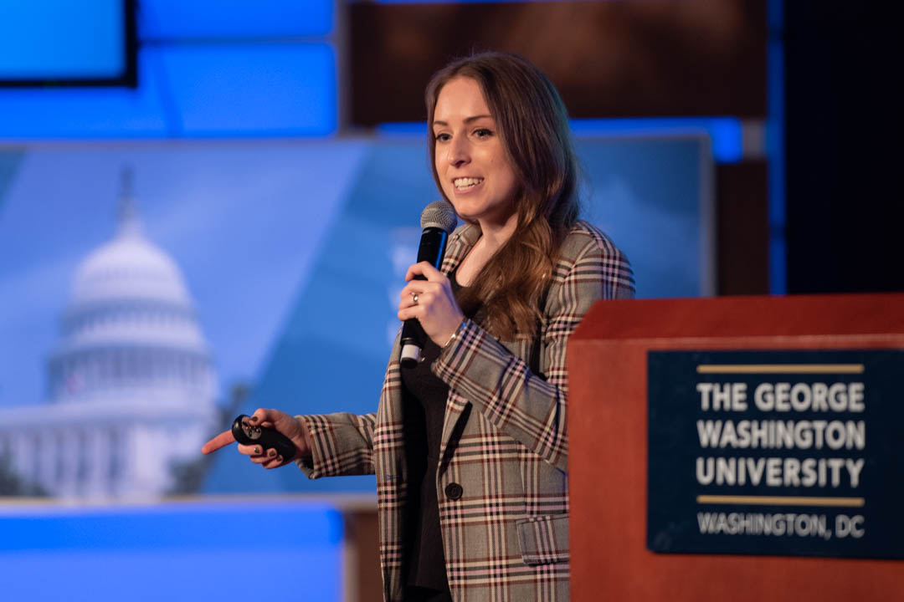
Organizational Intel - OpSec
How is an organization’s OpSec?
What is the email format (firstname.lastname)
Preferred _______ (airline, hotel etc.)
What are their IT/security protocols?
Do org members have strong opsec
attacking a company = attacking people
Internal document leakage
Rachel Tobac, Opsec/SocEng badass

Slide 25
Org Intel - Information Gathering
Abuse public sources of information
Zoominfo / Yellowpages + uname format = power
LinkedIn
Boomer companies have lots of people on LinkedIn
Quickly → HUMINT
Public company websites
Can expose phone numbers, emails, etc

Slide 26
Org Intel - Policy Information
If the service has a public facing account system, likely they use same password security for backend.

Slide 27
Human Intelligence
Who is this person?

Slide 28

Human Intelligence
This is easiest thing to learn
Creating a map of a person
Everything from social media to IRL address
Tons of different methods, too many to put on a summary page

Slide 29
Human Information Gathering Methods
Easy Mode
Social Media
Shared Username, use Sherlock
Medium Mode
In depth searching utilizing Google Dorking etc
Look around networked profiles (friends, followers etc)
Paid Services
Invalid like 95% of the time
If multiple paid services point to same thing it might be valid
Hard Mode
Voting Records
Can enumerate given birth month and address
make new friend
Social Engineering
be GODDAMN careful about your motives

Slide 30
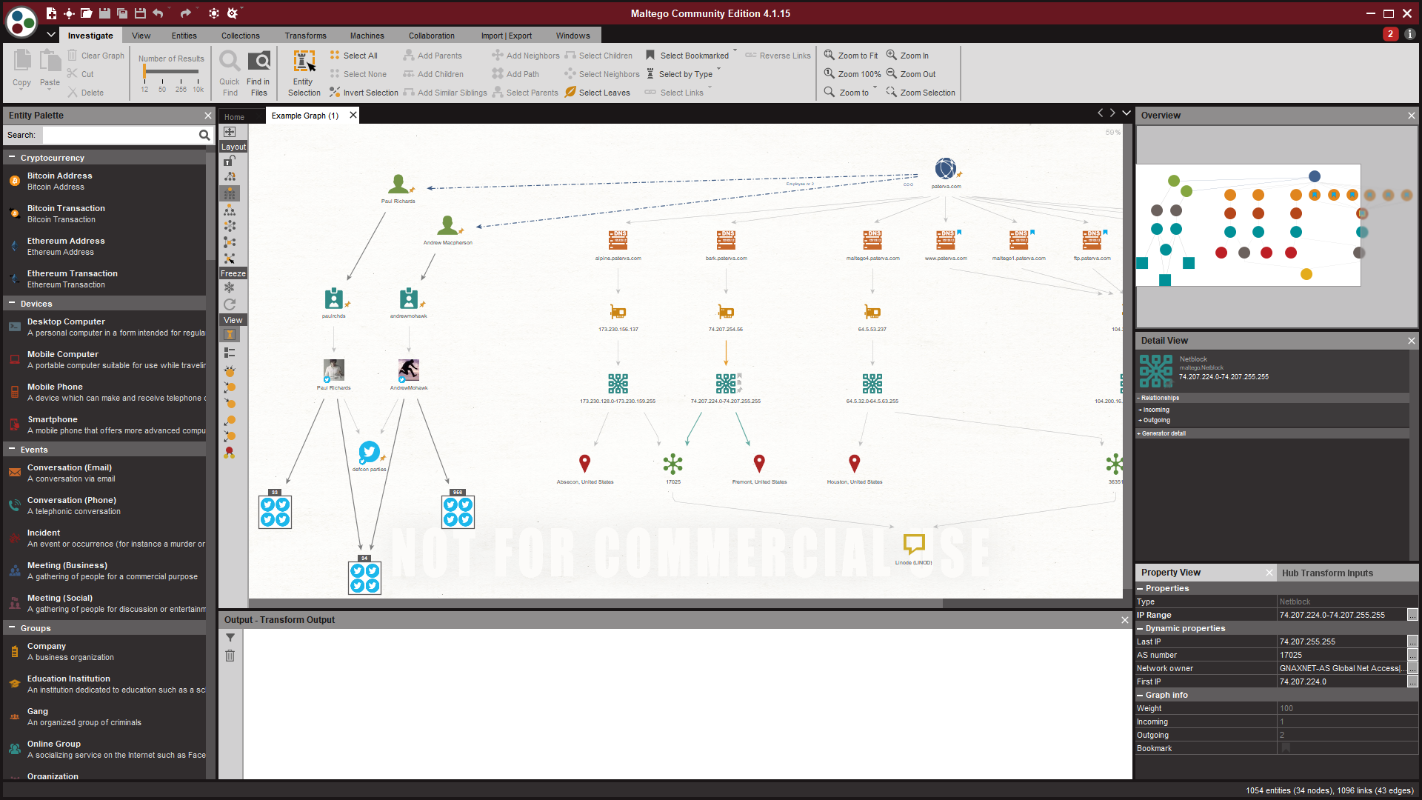
Human Information Gathering Methods
Profiles
Links, pictures, stuff that goes to other stuff
Build a map of someone
Username Reuse
Same across lots of places!
Helpful for these chals!
Images
Reverse ____ searching!
Deleted Content
Archivists save old websites!
Wayback machine!

Slide 31
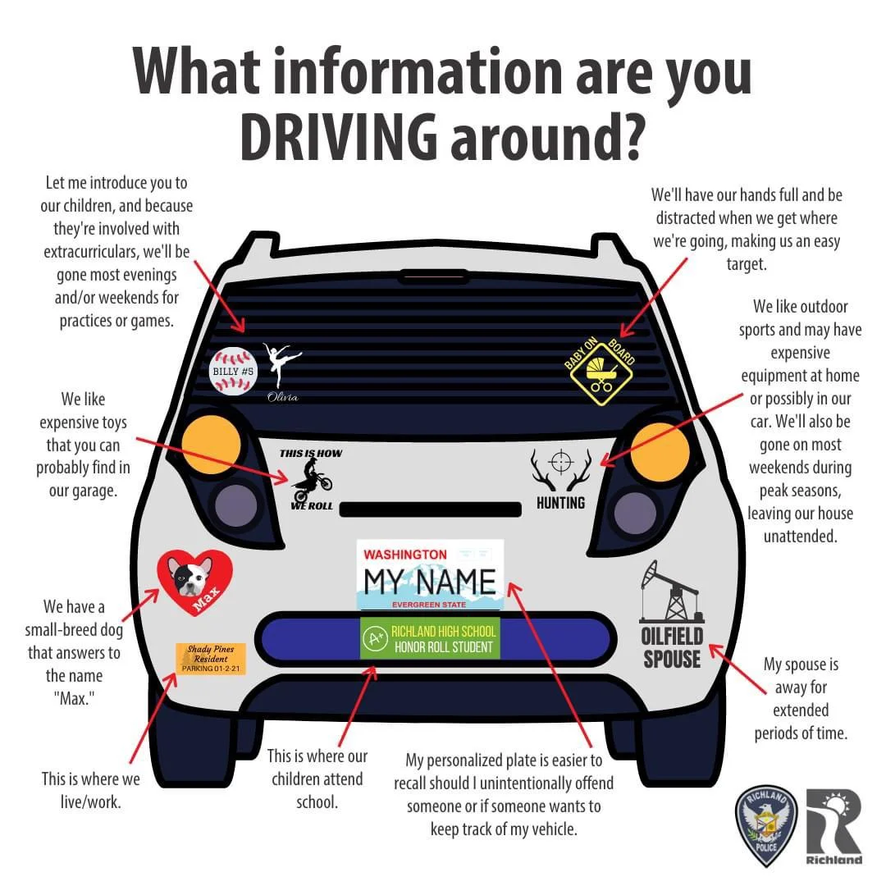
Information Leakage

Slide 32
General OSINT Methods
Mostly applies to everything

Slide 33
OSINT Tips - Identities
Split Identities
Most people have two identities online
Professional
Casual
Your job when doing OSINT is to link them
Sherlock
Can be used to find specific usernames on tons of platforms.
Definitely try it on your usernames!

Slide 34
OSINT Tips - Human Networks
People have friends
and connect with them online
abuse this to find information about a target
Check Friends/Family/Followers
Is a target tagged in something? Are they mentioned? Did they respond to a friend?
Friends & family may have information about a target
Birthdays and Facebook :(

Slide 35
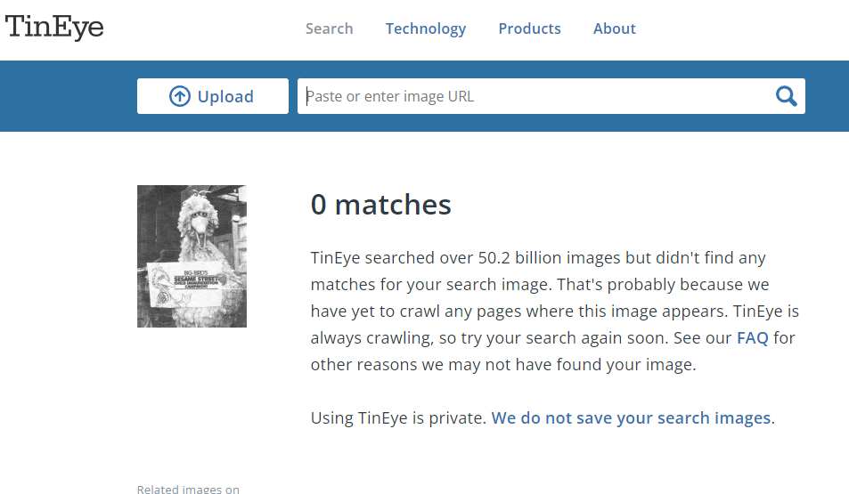
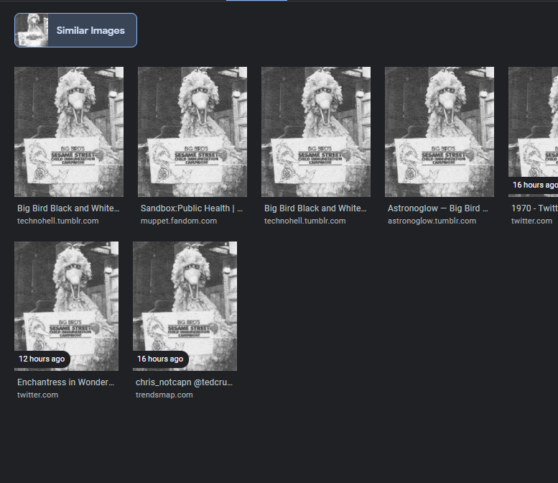
Media OSINT
Tineye, Yandex, Google Image Search
Keyword searcher
Cropping
Tineye: exact matches
Google: Similar
GOOGLE LENS IS YOUR FRIEND

Slide 36
Profile OSINT
Look for description
Reset password -> email / phone number, crossref with other osint to verify
kinda sussy

Slide 37
Secure osint methods
Don’t get caught lol
Thomas you know what this slide is about so how about you talk about it hahahahahahaha
Also Thomas but tired
(TLDR Use VPN / private browsing & don't try noticeably attacking someone)

Slide 38
OSINT Tips - Detection
Don't make noise
Don’t do things that would get you noticed
LinkedIn Page Views (STAY ANONYMOUS, DON'T DO A LOT)
Learn from my mistakes, don't REPLY TO A COMMENT ASKING ABOUT SOME PIECE OF INFORMATION ABOUT SOMEONE.
Viewing content is generally fine, creating content will often get you noticed. Stay low, stay out of the way, just make acct and look at what you need to.

Slide 39
OSINT Tools - Maltego
OSINT Mapping tool with extra features
Has “Transforms” that can connect.
Definitely give the Community Edition a Spin
Maltego at work

Slide 40
Other OSINT Resources
Michael Brazzel - Open Source Intelligence Techniques (The OSINT Bible)
Tracelabs - OSINT on real missing persons cases
Bellingcat OSINT - Cool OSINT Firm
https://ctf.cybersoc.wales/ : 24/7 Live OSINT CTF (many chals)

Slide 41
Thank you very much
The next many slides have information about specific websites that you can use for specific challenges / you may find useful -- open them on your own computer if you’d like to browse them.
This is a living presentation, and every so often I will update it, eventually it may get really big!
Follow @Thomas_Quig on twitter ;) Find something about me I didn’t know/forgot was on the internet for many

Slide 42
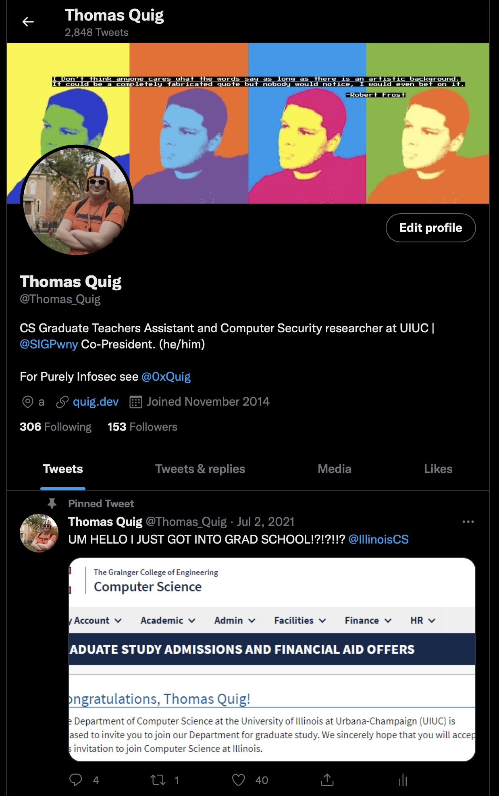
Twitter
TWEETS & replies are ALWAYS WHERE YOU SHOULD LOOK FIRST
Twitter bios have info, location, birthday, and a link to somewhere
Advanced Searches: good
Follower / Following lists can help find friends

Slide 43
Twitter
TWEETS & Replies is ALWAYS WHERE YOU SHOULD LOOK FIRST
Twitter bios
Advanced Searches
Twitter has an advanced search bar, but it also has extra parameters.
https://lifehacker.com/search-twitter-more-efficiently-with-these-search-opera-1598165519
from:@ vs to:@ vs @
near: and within:
since: , until: , before:
:) , :( , ? operator, all boolean operators
“” vs just typing it in (keyword vs string)
Check who they are following, check who is following them
Twitter API is pog
Check in several places
Mentions (to and from), media (ALT Text), LISTS, Likes!!, Image Tags / Location
Sent application (TweetDeck)
Reply list, retweet list etc etc.

Slide 44
Youtube
Youtube doesn’t allow you to search for comments, which makes makes finding information by comment searching difficult.
Look for information that the channel left public. There is A LOT of it
Even if the discussion page is not visible, you can usually go there by adding /discussion at the end of the link.
Youtube sends you the full banner image, not just the crop.
About page
Often has EMAIL if the person was not paying attention on setup.
Advanced search queries
Many are same as the other websites
https://tubularinsights.com/advanced-youtube-search-tips/

Slide 45
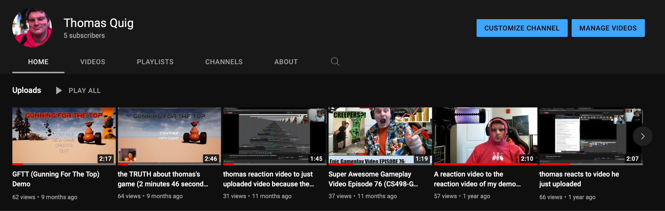
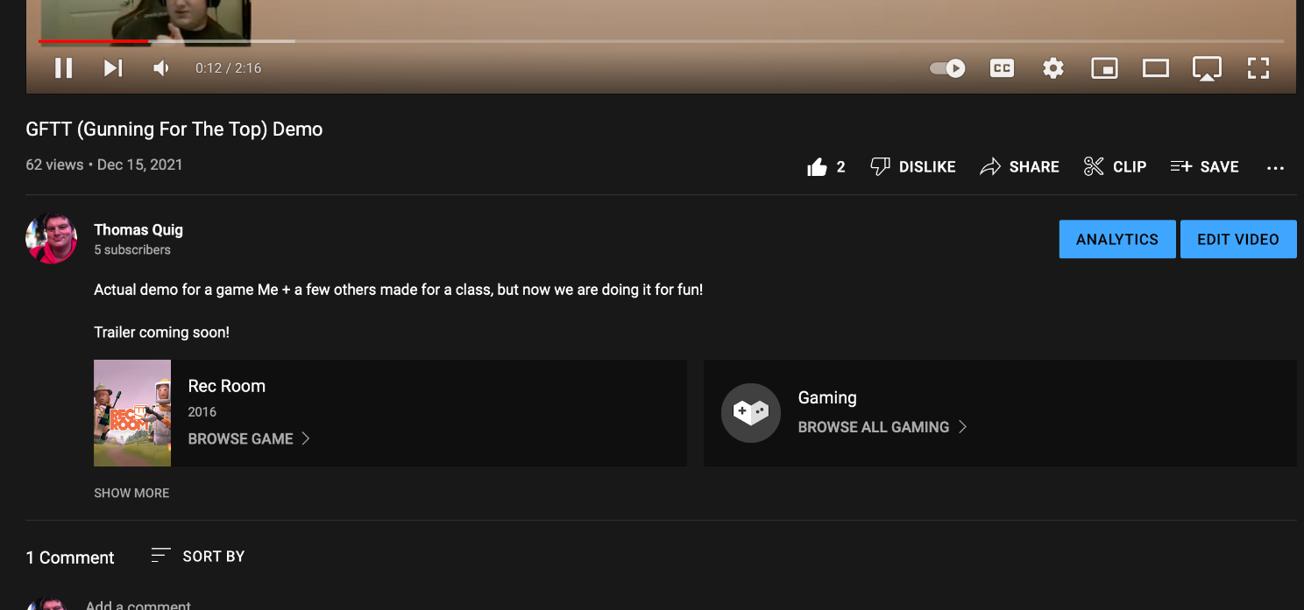
YouTube
Channels
Banner, Profile Picture
About tab, playlists
Playlists
Unlisted videos are visible
Videos
Closed captions, different languages. 3 Englishes!
Description, comments (not searchable)

Slide 46
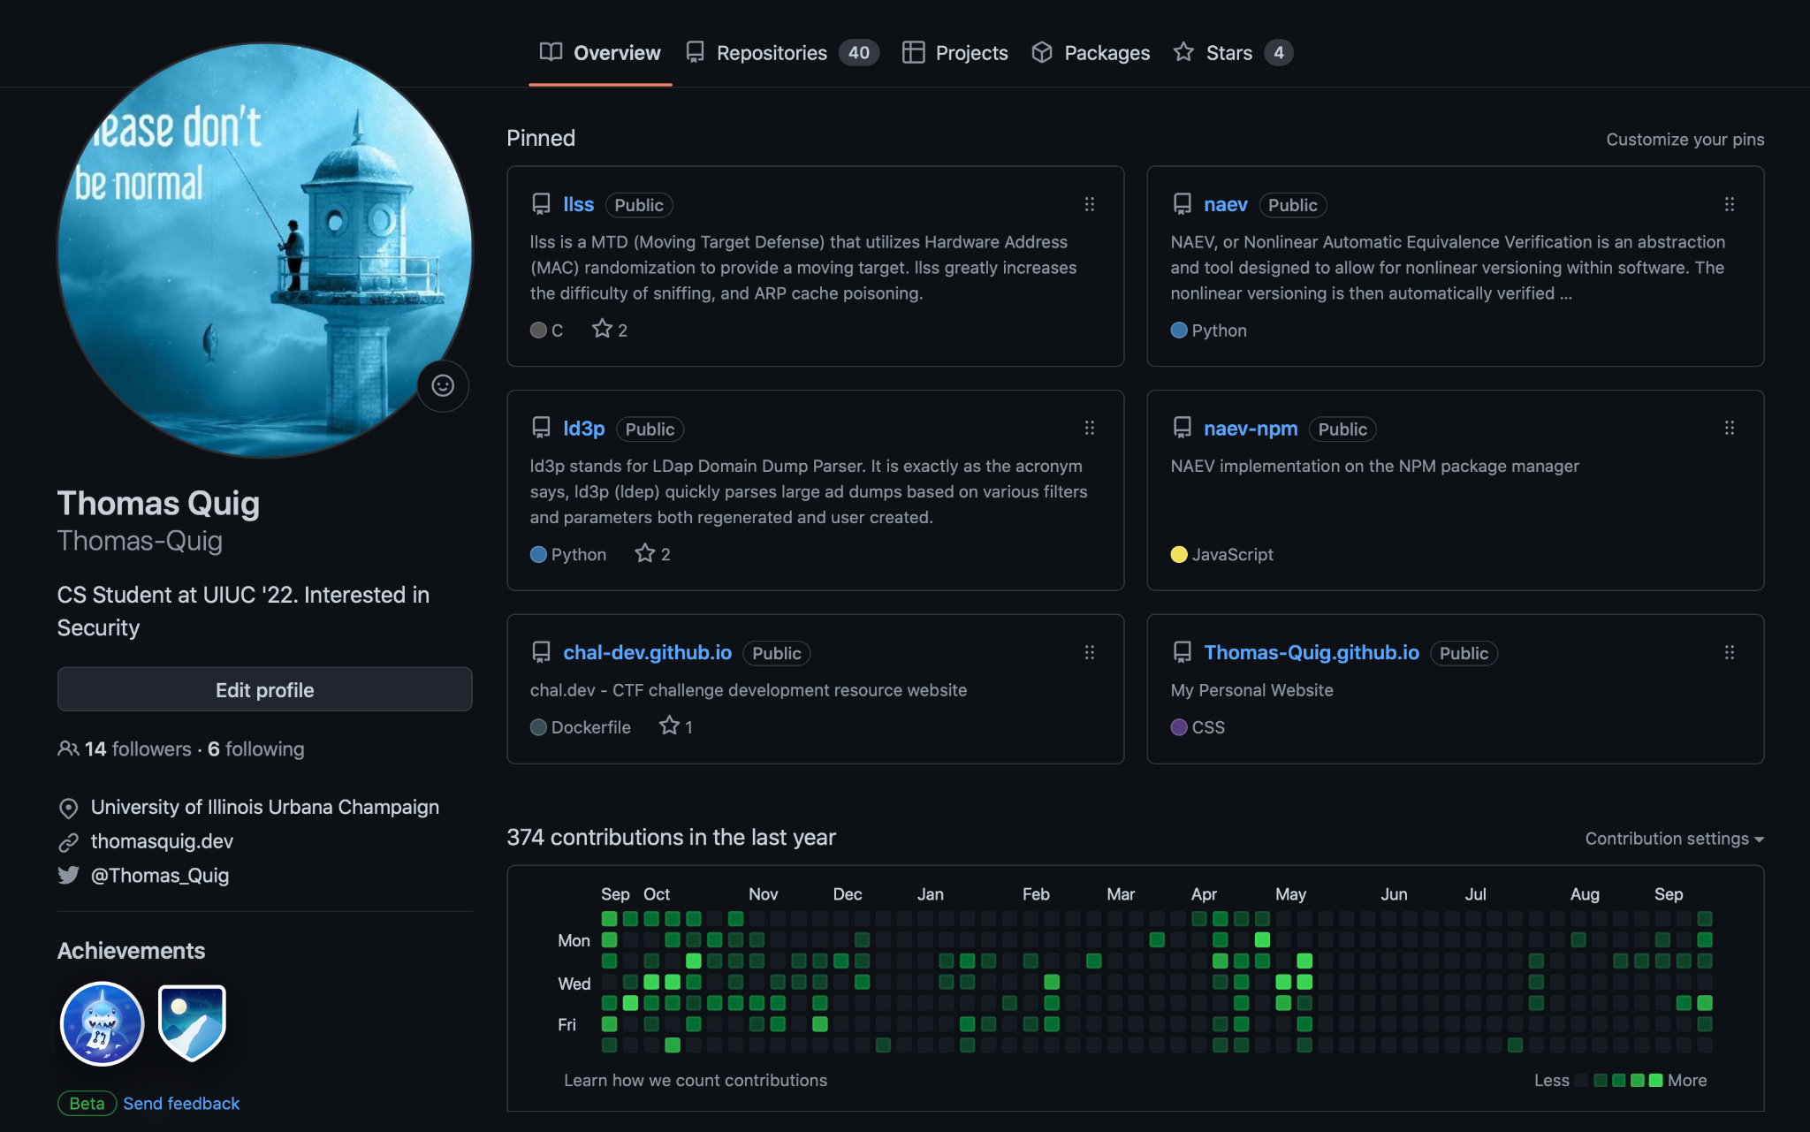
GitHub
Profile page
View featured repos
Links, socials, location
email
Repositories
Commit history
Pull Requests & Comments
Comments / User Content
Can exist in many places

Slide 47
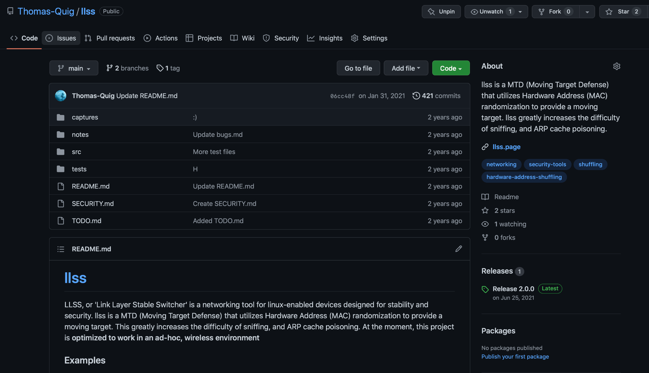

Slide 48
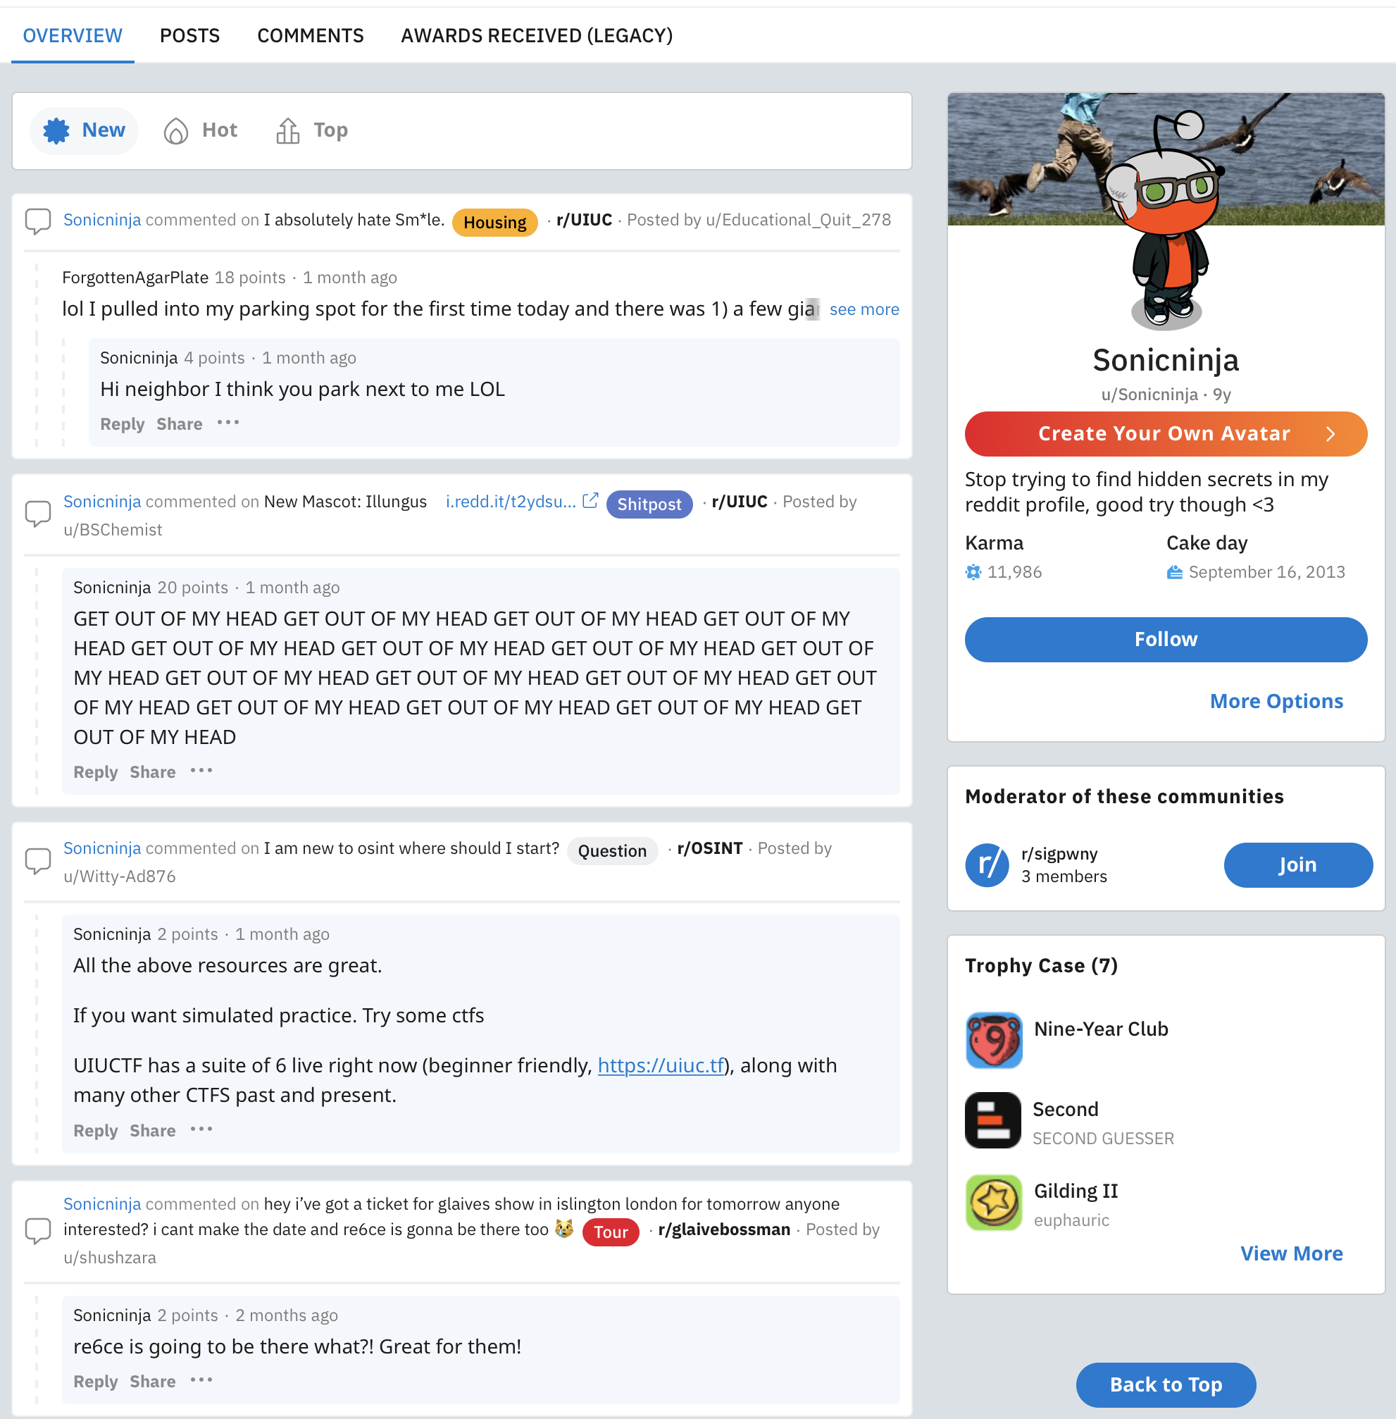
Reddit
Reddit is a semi-anonymous website
Link people to other platforms
Profile
Profile Pictures, Banner Photos
Comments, posts, links
Moderator
Awards
Posts
Search by top
old.reddit.com

Slide 49
Reddit
Reddit is a semi-anonymous website
Some people deanonymize themselves.
Ex. President Obama, u/Giga_Gamby
Some people deanonymize themselves accidentally
u/Badongschlong, Yours truly.
Everyone gets sloppy.
If you look long enough, you can usually link someone to a different account
Search techniques
https://www.reddit.com/wiki/search
Author:
Selftext:
Boolean Operators
Comments NOT included in searching on reddit.
Believe it or not you can actually have profiles

Slide 50

Imgur
Comments exist, and you can see all of them for a profile
Every image uploaded is public, even if it is not actually public

Slide 51
Actual Websites
Refer to web challenges (robots.txt, sitemap.xml etc)
Check about me pages, contact us pages, look for specific people.
Don't be afraid to use inspect element (We are in Illinois not Missouri)
Look for backend (/wp-admin) and try default credentials if permissible
TRY ONLY ONCE, DO NOT LOCK SOMEONE OUT!!!
Check whois, DNS Records

Slide 52
Gmail
Profile pictures have upscaled and uncropped versions
Get google id from email, view reviews and public shared photos.

Slide 53
Facebook
Facebook does not like it when you make fake accounts.
This one is pretty self explanatory but I will drop more info here in a bit.

Slide 54
Linkedin
This one is also pretty self explanatory
Email sharing on default, check contact info
Most people don't lie on linkedin, and you are able to get a lot of info from it.

Slide 55
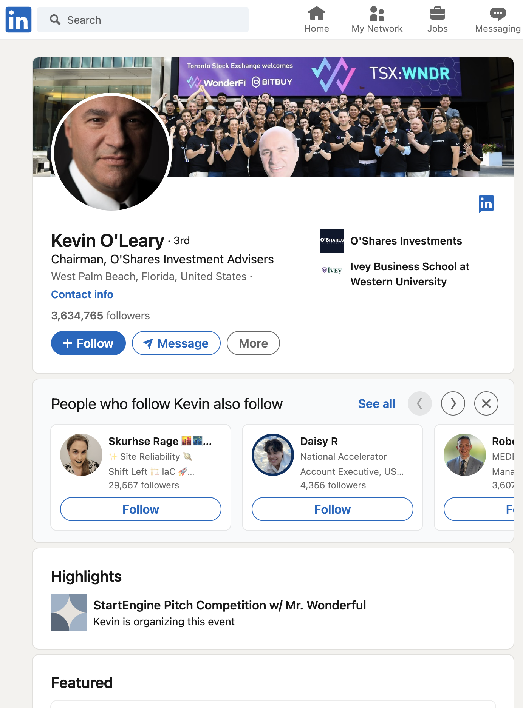
LinkedIn
LinkedIn is a very open website
Most people tend not to lie or be very hidden
Profile
Profile & Banner Pictures
Posts, Comments, Socials
Experience, Education, Skills, and Activity
Email, Phone Number, and Address
Comments / Content
Easily accessible to all

Slide 56
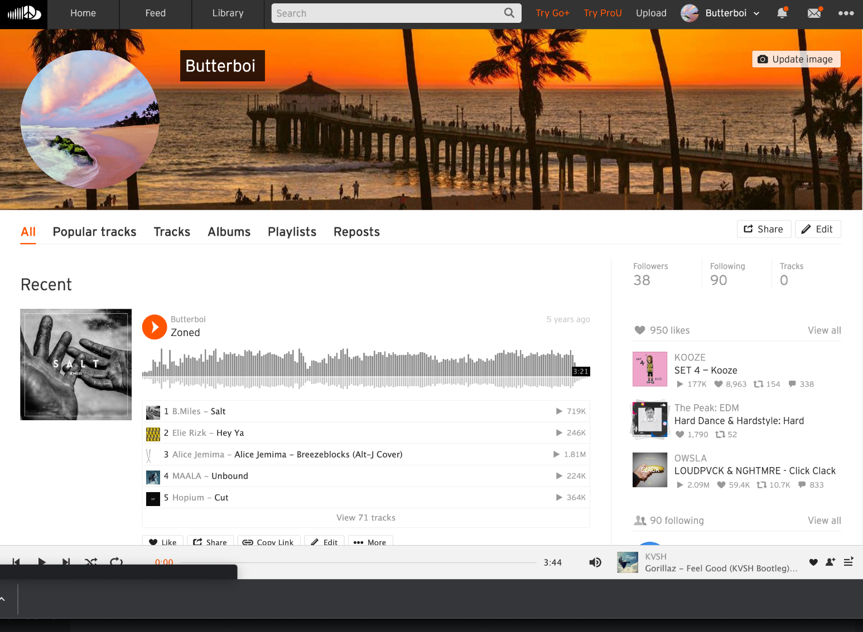
SoundCloud
SoundCloud is a semi-anonymous website
Often link to other socials; yet can be as anonymous as they want
Creators / Publishers are more vulnerable
Profile
Posted media, Profile Picture, Socials
Likes, Comments, and Reposts
Followers/Following
Playlists

Slide 57
Discord
Mutual servers, mutual friends
Profile photos, About Page, (NEW) Server PFP’s
Attachments are public, they all
See Kuilin’s Discord Recon challenges (will see if they work anymore)

Slide 58
Media OSINT: Image → Location
Look for landmarks
Landmark != big famous building
Books of Power and Knowledge
Text
Context is important
Limit the search space as much as possible
“He will not divide us 2” (internet historian) is an icky but great example of good image OSINT
Time
Think out of the box, it takes time but most images can be found
Geoguessr 0 movement challenge

Slide 59
Media OSINT
OPEN IMAGE IN NEW TAB!!!
Tineye, Yandex, Google Image Search
Keyword searcher
Cropping
Tineye: exact matches
Google: Similar
GOOGLE LENS IS YOUR FRIEND

Slide 60
Media OSINT: Image → Location
Text : google things you can understand! add keywords!
Background information
Color of floor / walls / carpet.
Where are you? Can you guess?
Limit your search space!!
Corroboration with other things
Check websites related to locations
Google Photo Reviews!
Stores have websites!

Slide 61
IRL Stuff (Location, Phone #, etc)
Voting records, whitepages, etc.
I gave myself too many things to finish, but I will happily talk abt this stuff.

Slide 62
Challenge Collection
UIUCTF 2020 - HackerIsabelle (6 challenges)
UIUCTF 2021 - ChaplinCoding (8 challenges)
UIUCTF 2022 - Chucklephucke (6 challenges)
SP 2019 - TotallyAHuman3025 (11 challenges)
Fall CTF 2021 - SpaghettiEsports (3 challenges)
CCC 2021 - con_angry (3 challenges)
Fall CTF 2022 - Spoingusthecat (4 challenges)
FA 2022 - Check ctf.sigpwny.com (8 challenges)
Those are the usernames for the first challenge of each suite, go figure out which platforms they belong to!!! Let us know if you are stuck / something seems down or broken

Slide 63
Next Meetings
2022-10-02 - Assembly (Seminar)
Learn how assembly works!!!
2022-10-06 - PWN/Binary Exploitation I (Regular Meeting)
Attack binaries!!! Buffer overflow!!

Slide 64


